Slide 1
Project: Image to Pencil Sketch App
Presented by:
Harshita Anantula – 100925323
Alexis Lewis – 100987937
Lubna Mohammed Alfaz – 100945841
Manthan Zala – 100931611
Date:05/02/2025

Slide 2

Introduction
Objective: Build an AI-enabled application to artistically process raster images into pencil sketch and similar formats.
To demonstrate proficiency, app should have several filters and voice-enabled features.
Scope: focus on developing filters, speech recognition, and possibly a fine-tuned LLM with differentiated command heads (for rotation, translation, saving etc.) fine-tuned via SVF.
Business Impact: The application is a consumer product rather than a tool for business to leverage, so the impact is that the business now has a product to sell.
Educational Impact: Team members will learn about computer vision, NLP, cloud deployment, possibly fine-tuning and hopefully demonstrate “end-to-end AI application development skills”.

Slide 3
Plan & Technology Framework
Phases:
Planning: Examine candidate features, feasibility, and select features based on a balance of feasibility and perceived potential to increase application market value
Development: Develop filters variations using OpenCV, possibly fine-tune LLM with custom heads that activate output neurons when asked to perform certain key actions. Build API backend.
Testing and Deployment: Test out filters and speech recognition/NLP models under diverse conditions; also build the front end
Deliverables:
Prototype (filters and simple voice commands) by March 05
Competent draft (at least 5 or 6 features) April 02
Final product prior to April 16
Technology:
AI Framework: PyTorch for SVF, customizing LLM heads
Data Engineering: Pandas, SQL w/ DuckDB if necessary
Cloud Platform: Google cloud has some cloud speech to text enabled by GCP APIs, also has some generous free-tier hosting options; not positive we will go with GCP though.
Integration: Possibly FastAPI or Django

Slide 4
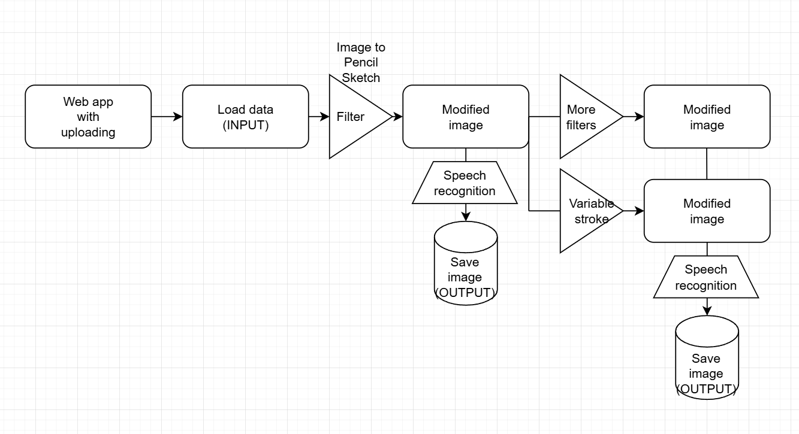
Application Flow

Slide 5


THANK YOU

